Slide 1

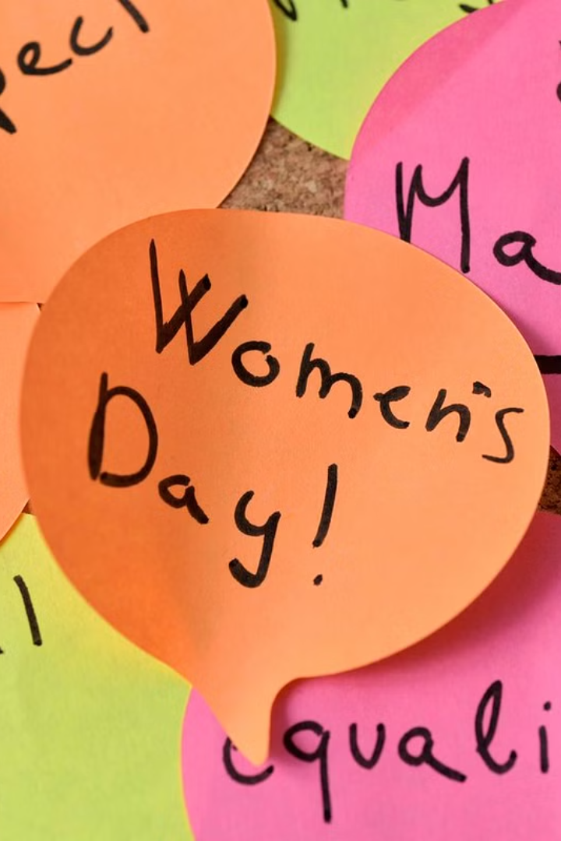
Introduction to International Women's Day
International Women's Day is a global day celebrating the social, economic, cultural, and political achievements of women. It also marks a call to action for accelerating gender parity.
pa
by prity jha

Slide 2

History and Significance of Women's Day
1
Origin
First celebrated in 1911, it emerged from the activities of labor movements.
2
Significance
Represents a focal point in the movement for women's rights and gender equality.
3
Evolution
Transformed into a recognized global event to celebrate the advancement of women.

Slide 3
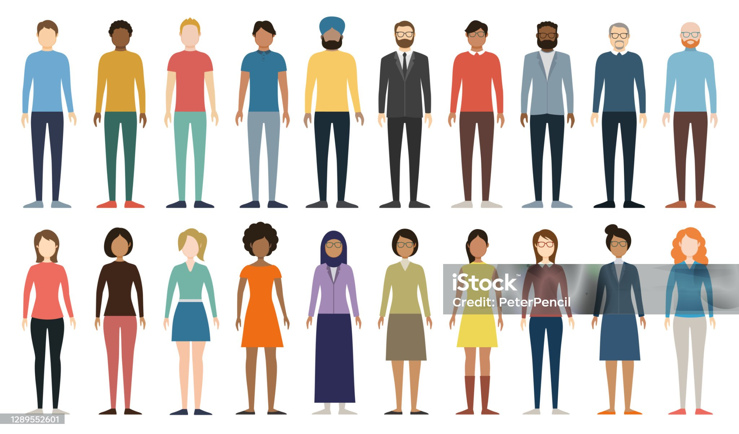
Achievements and Milestones of Women's Rights
1
Legislation
2
Workforce
Passing of laws to protect women's rights and ensure equality.
Breaking barriers in various industries and roles traditionally dominated by men.
3
Leadership
Women's increasing presence and influence in political and corporate spheres.

Slide 4
Current Challenges and Issues Faced by Women
Violence
Discrimination
Health
Continued prevalence of physical, sexual, and emotional abuse towards women.
Systematic biases in education, employment, and public domains based on gender.
Unequal access to healthcare and prevalent reproductive health issues.

Slide 5



Celebrating Women's Achievements and Contributions
Leadership
Science & Innovation
Arts & Culture
Women leading organizations, communities, and initiatives.
Contributions to scientific breakthroughs, technology, and research.
Impact in literature, art, music, and cultural preservation.

Slide 6




Promoting Gender Equality and Empowerment
Education
Workplace
Advocacy
Ensuring access to quality education for girls and women.
Promoting fair employment practices and equal pay.
Rallying for basic human rights and women's well-being globally.

Slide 7
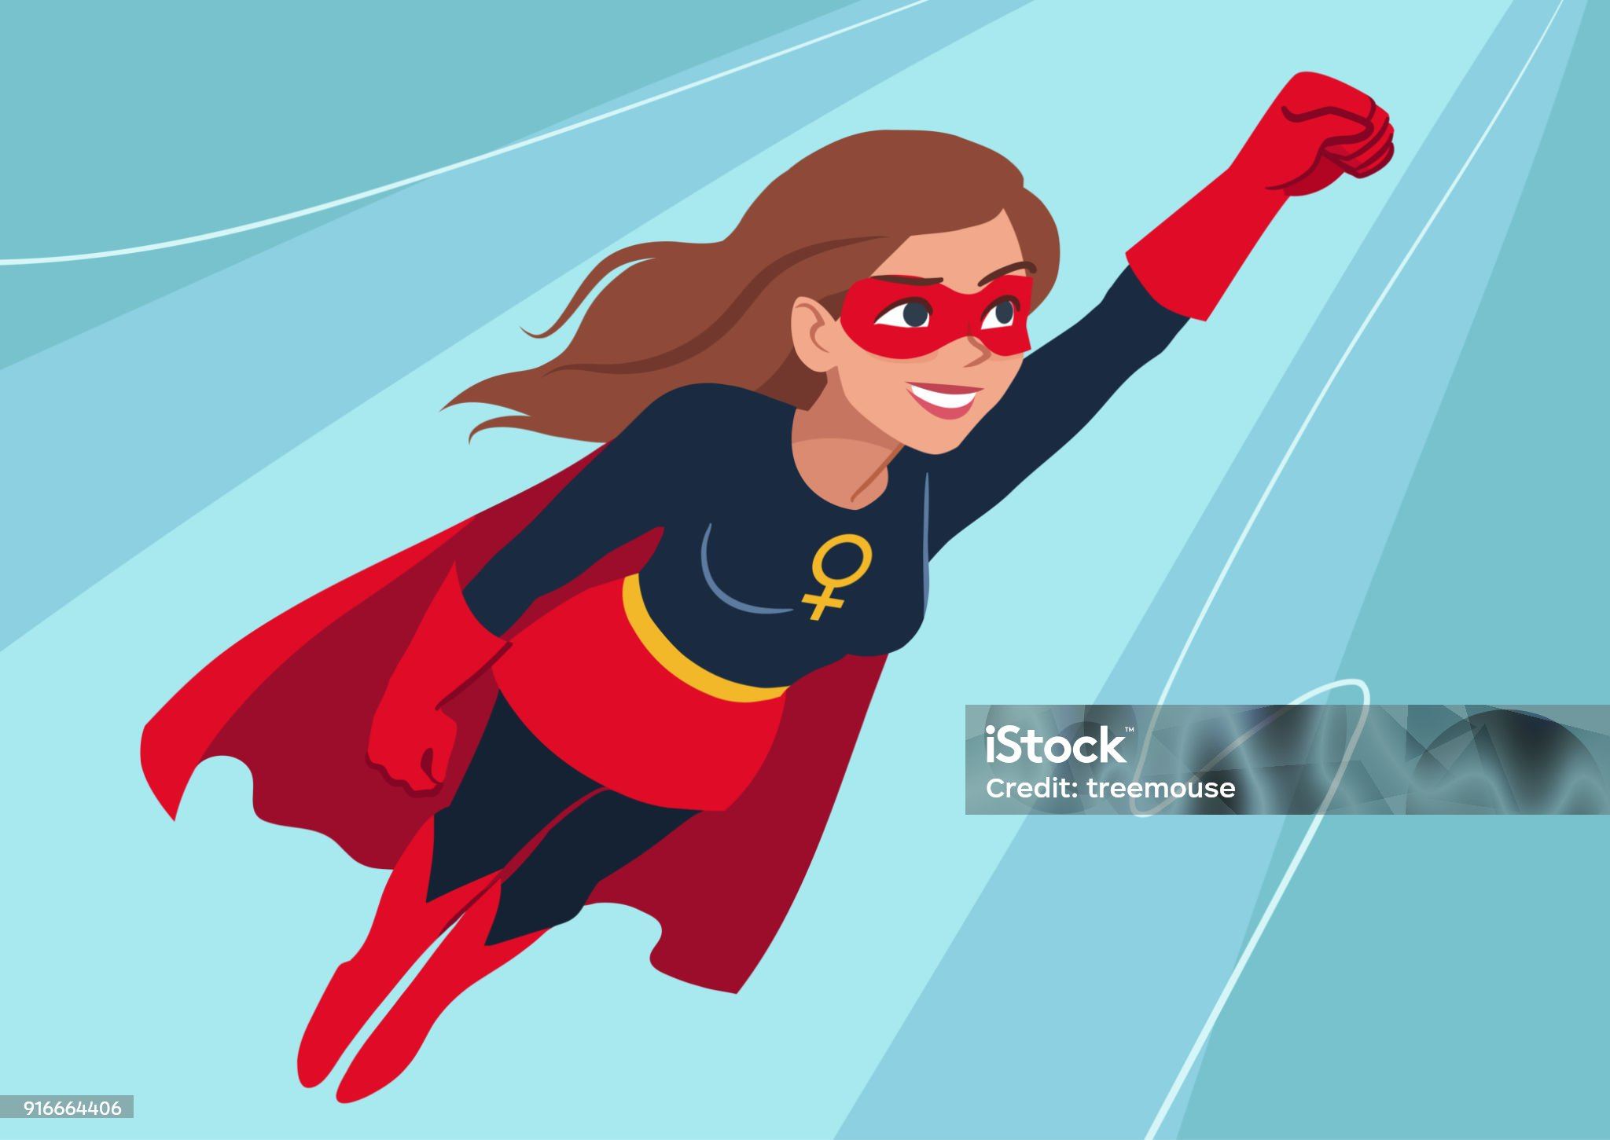

Inspiring Stories of Influential Women
Malala Yousafzai
Ruth Bader Ginsburg
Advocate for female education and Nobel Prize laureate.
Led the fight for gender equality on the U.S. Supreme Court.
Margaret Hamilton
Directed the software engineering division for the Apollo project.

Slide 8
THANK YOU
Call to Action: How to Support and Advocate for Women's Rights
Donate
Volunteer
Educate
Donate
Volunteer
Educate
Contribute to organizations supporting women's rights and issues.
Offer time and effort to causes that benefit women and girls.
Spread awareness and educate others about women's rights and gender equality.

